Slide 1

WELCOME
Induction presentation for new parents
July 2025

Slide 2
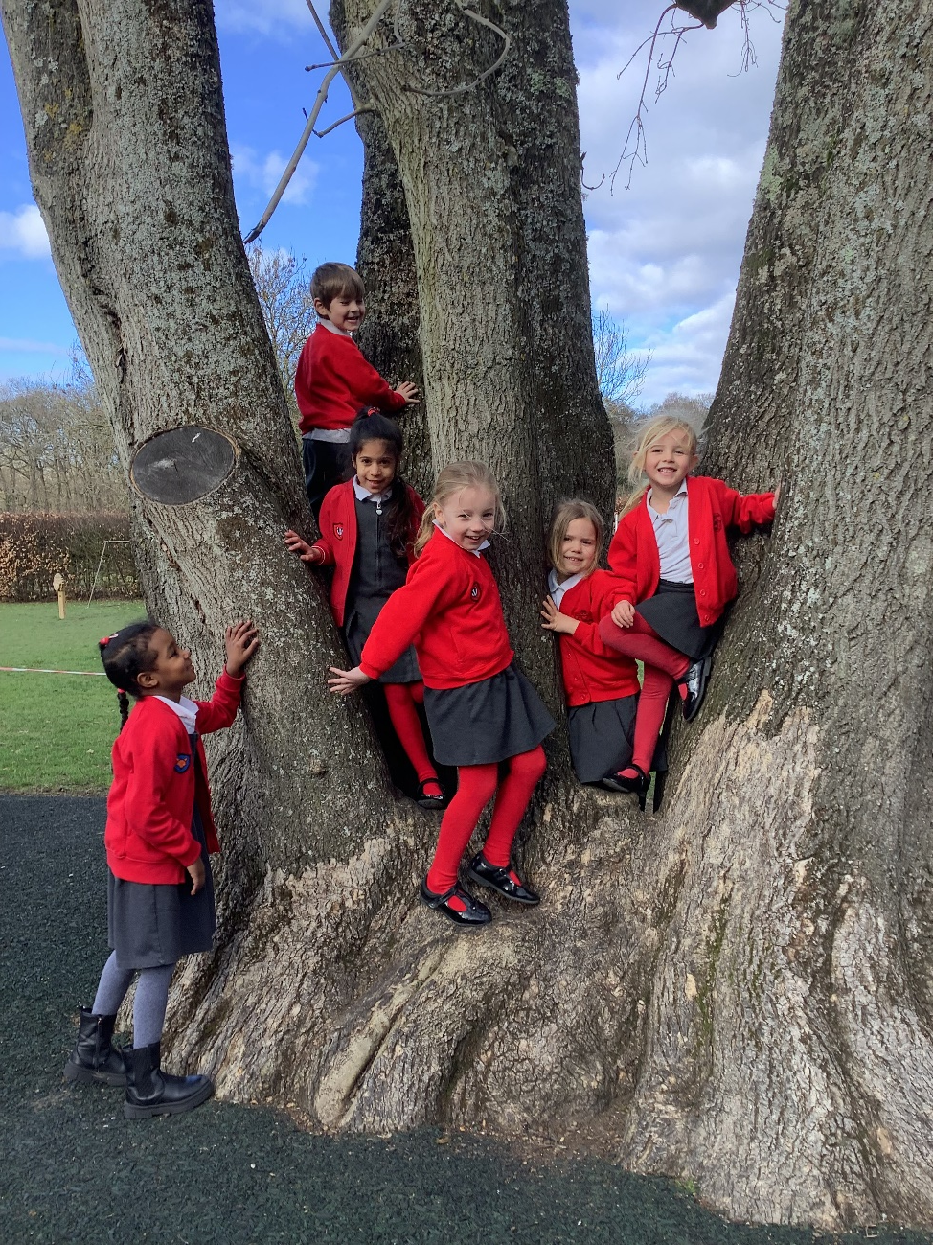
CONTENTS
STAFF
VALUES
SCHOOL DAY
PARKING
FIRST FEW WEEKS
UNIFORM
COMMUNICATION
GETTING READY
ONE MORE THING …

Slide 3
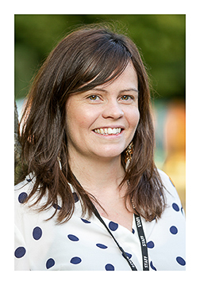
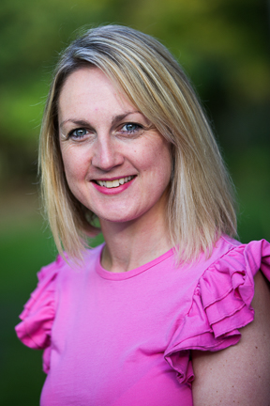
1. STAFF
LEADERSHIP TEAM
Mrs Waugh
Co headteacher
Mon-Wed
Wellbeing
Pastoral
Behaviour
Miss Douglas
Co headteacher
Wed-Fri
Curriculum
Assessment
SENCo

Slide 4
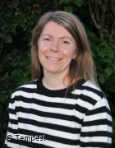
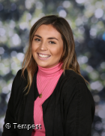
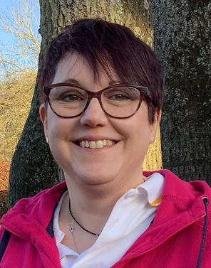
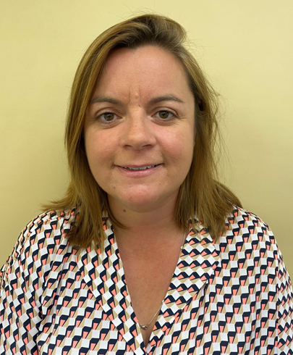
1. STAFF
Reception Team
Mrs Carroll
Class Teacher
Mrs Burrell-Brown
Class Teacher
Ms Patterson
TA Monday
Mrs Johnson-Wernham
TA Tues - Fri

Slide 5
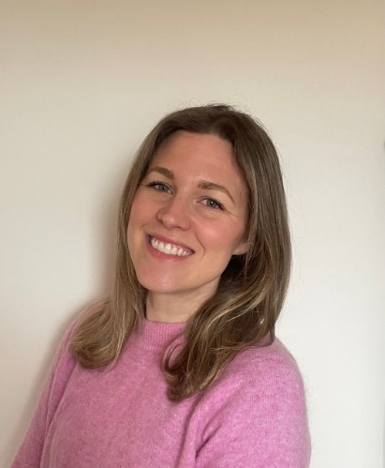
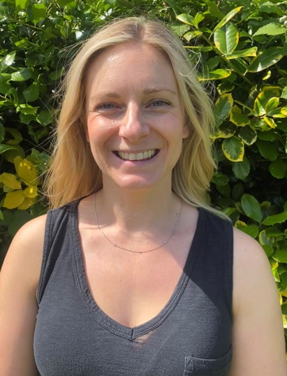
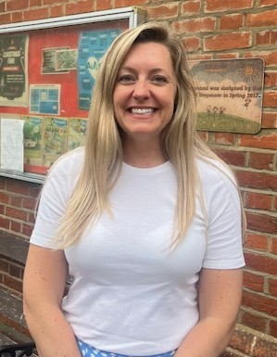
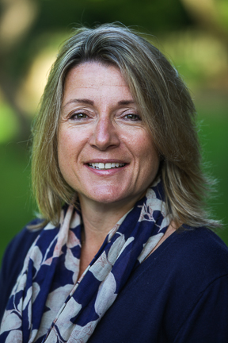
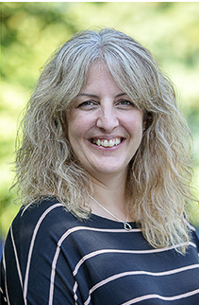
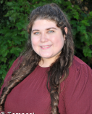
1. STAFF
Key Stage 1
Mrs Dusek and Mrs Singh
Year 1 Teachers
Mrs Moat (Maternity Leave cover)
Mrs Redrup
Year 2 Teacher
Teaching Assistants – Mrs Cooper, Mrs Emmett, Miss H

Slide 6
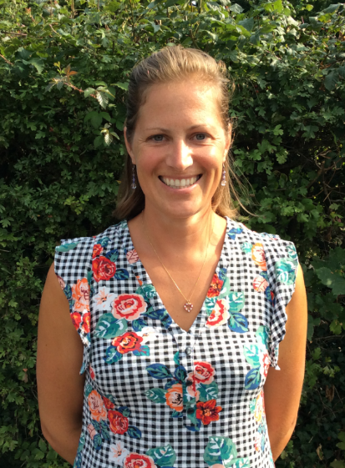
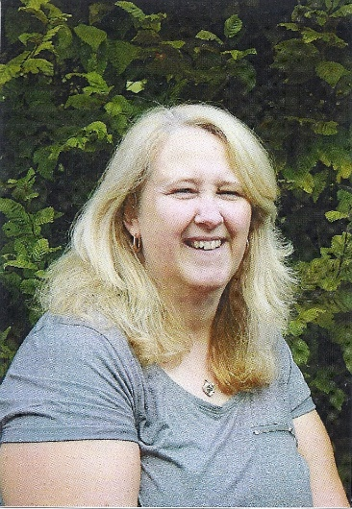
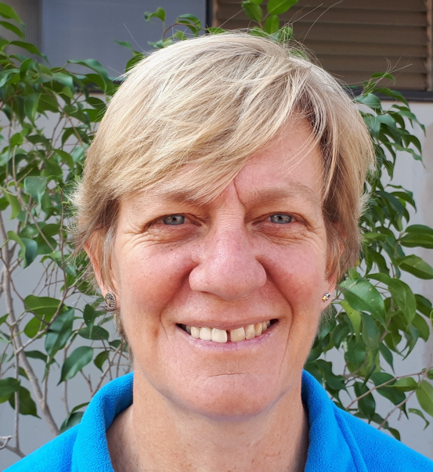
1. STAFF
Mrs Fearon – School Office / Administration
Mrs Aldridge – Midday supervisor
Mrs CB – Midday supervisor

Slide 7
2. Our School Values
Independence, Curiosity, Respect,
Kindness

Slide 8
3. THE SCHOOL DAY
KISS & DROP @ 5-bar gate
8:45-8:55 Whole School
Please leave immediately after dropping off to free up parking
spaces for other parents.
COLLECTION on playground (gate opens at 2:55pm)
3:00pm Whole school
WRAPAROUND CARE
8:00-8:45am Breakfast club 3:00-4:00 After School Clubs
8:30-8:45 Early drop-off 3:00-5:30 Wrap Around Care
(Fridays till 4:00pm only)

Slide 9

Timetable
3. THE SCHOOL DAY
Monday Mrs Burrell-Brown | Tuesday Mrs Burrell-Brown | Wednesday Mrs Carroll | Thursday Mrs Carroll (Mrs Waugh to Oct) | Friday Miss Carroll (Mrs Burrell-Brown to Oct)
EYFS activities inc English, Maths & Phonics Writing focus | EYFS activities inc English, Maths & Phonics Library | EYFS activities inc English, Maths & Phonics PE / PSHE | EYFS activities inc English, Maths & Phonics RE | EYFS activities inc English, Maths & Phonics
Forest School on a termly rotation with other year groups

Slide 10
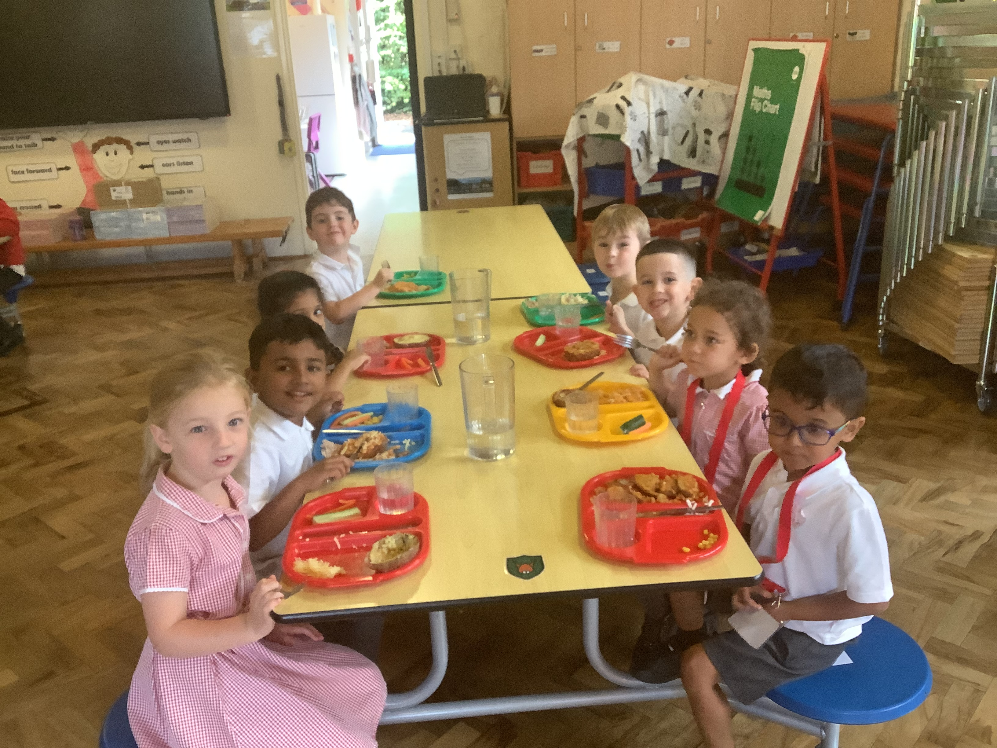
3. THE SCHOOL DAY - LUNCH
All children are provided with a school lunch through the Government Universal Infant School Meals Scheme.
School lunches are prepared freshly every day. We cater for all dietary requirements.
Everyone is opted in.
Lunch is served in the hall where children sit in house groups.

Slide 11
4. PARKING
Please make yourself familiar with the parking options
at our school.
REMINDERS:
Please DO use the Park & Stride options available as much as possible! HOUSE POINTS WILL BE AWARDED!
Please do NOT park on both sides of Littleworth Road.
Please do NOT park on Dropmore Road (by Old Lodge) as there is no safe crossing option.
Do NOT stop or park in our disabled parking bay (unless you have a valid disabled parking permit)
Do NOT wait, park or stop on school entrance markings (YELLOW).
Keep entrance clear at all times, even if picking up or
dropping off children.

Slide 12
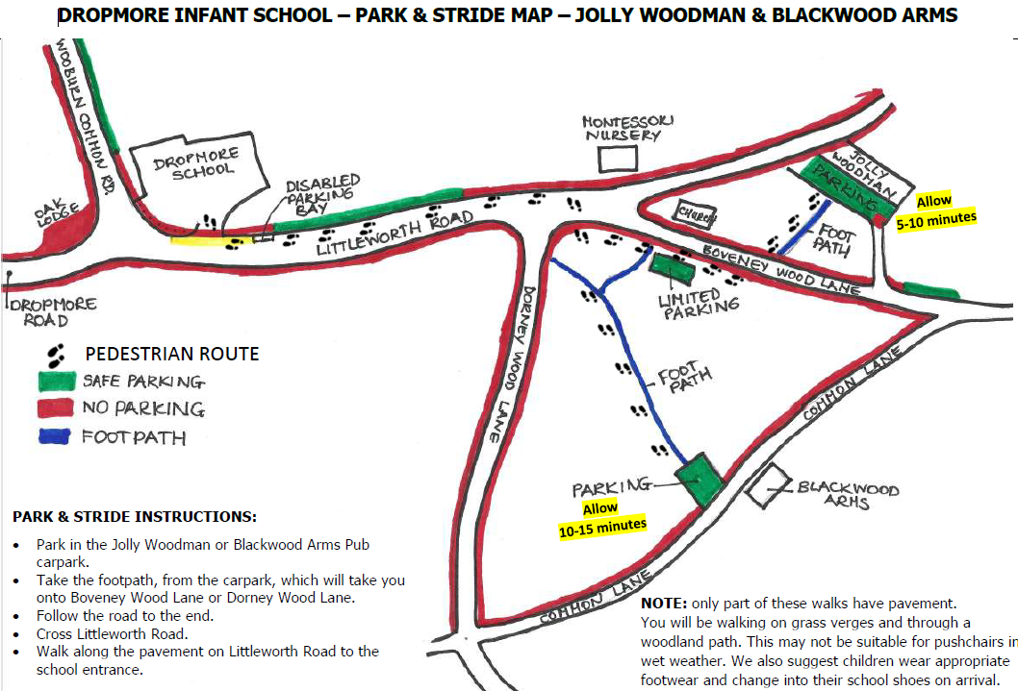

Slide 13
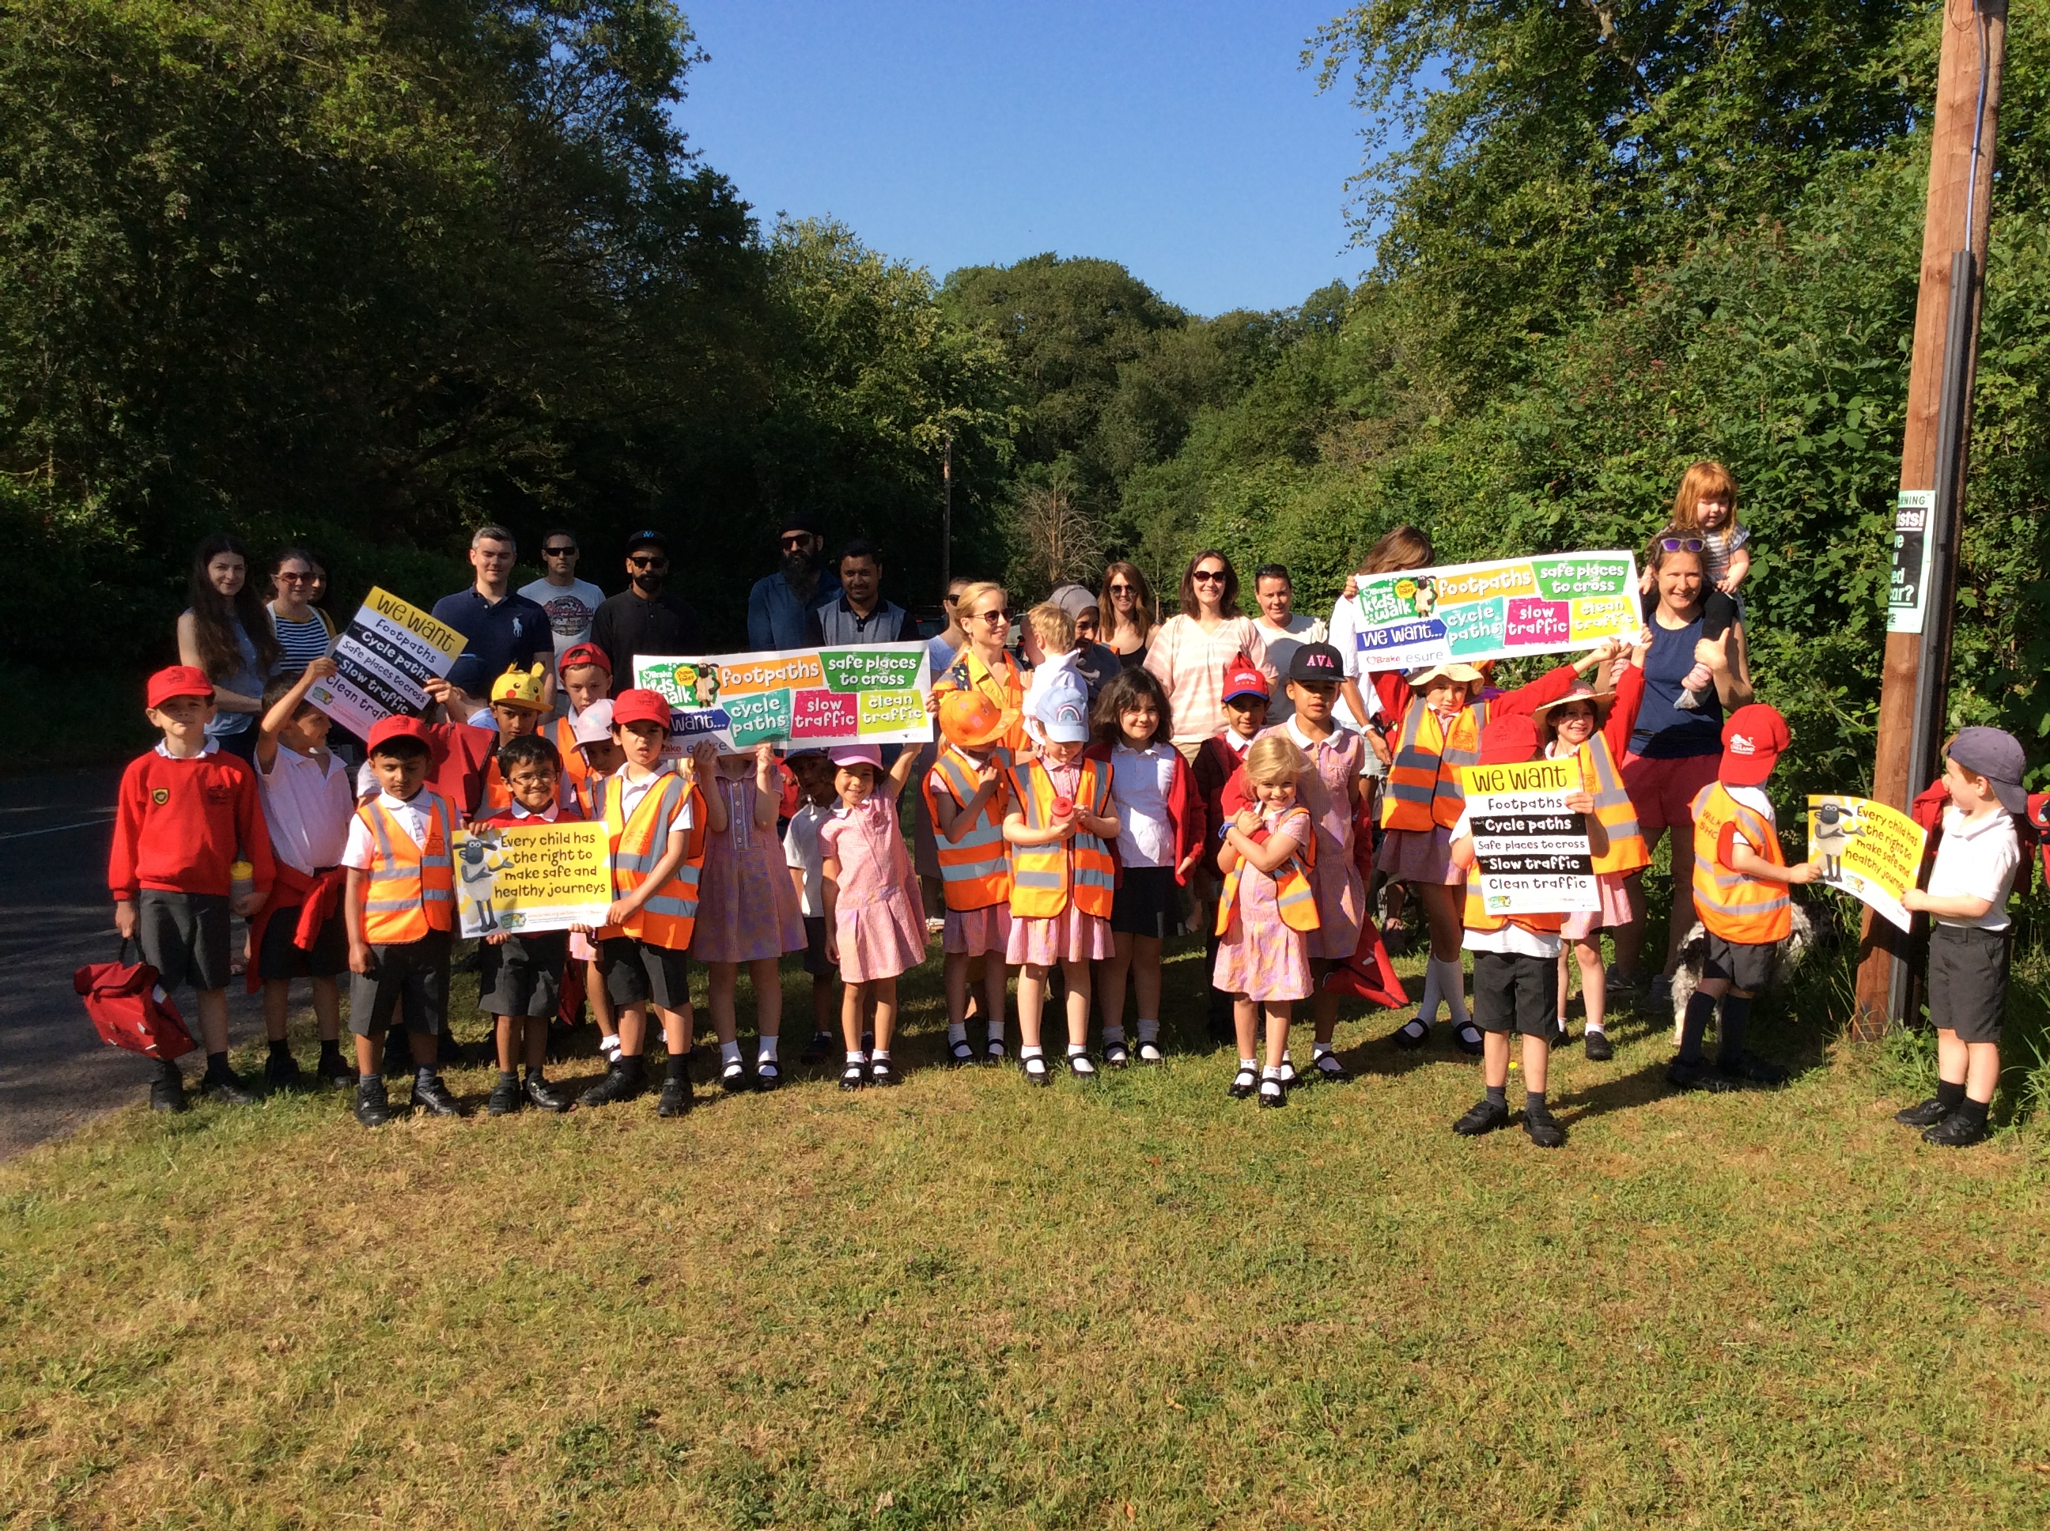

Slide 14
5. THE FIRST FEW WEEKS
Week 1 Monday 8/9/25 OR Tuesday 9/9/25 Wednesday 10/9/25 Thursday 11/9/25 Friday 12/9/25 | We will split the class into 2 groups (Group 1 and Group 2) Group 1 – Will attend school on Monday 8th September 09:15-12:00. If you already have a sibling at the school, you can choose to drop off early at 9am Group 2 – Will attend school on Tuesday 9th September 09:15-12:00. If you already have a sibling at the school, you can drop off early at 9am. All children 09:15 – 12:00 All children stay for lunch 09:15 – 13:00 All children will attend school for the full day. Arriving between 08:45-08:55 and being picked up at 15:00. From this day onwards, the children will be starting school at the same time as the other year groups. If you feel that a full school day would be too much for your child, please let us know and we can discuss an extended transition of collection at 13:00 for a further few days.
 | All children all day 08:45 – 08:55 Drop off and 15:00 pick up. Breakfast club, after school clubs and wraparound are open to Reception children from this week.
Week 2
15/9/25

Slide 15
5. THE FIRST FEW WEEKS
Group 1
Monday 8th September
Azalea
Charles
Lucas
Bonnie
Haaniyah
Raynav
Freya
Reginald
Scarlett
Fiadh
Elba
Arabella
Group 2
Tuesday 9th September
Angad
Amal-Fatimah
Antigoni
Ethan
Louie
Ailo
Yasmine
Gyan
Jayce
Felix
Fern
Hunter

Slide 16
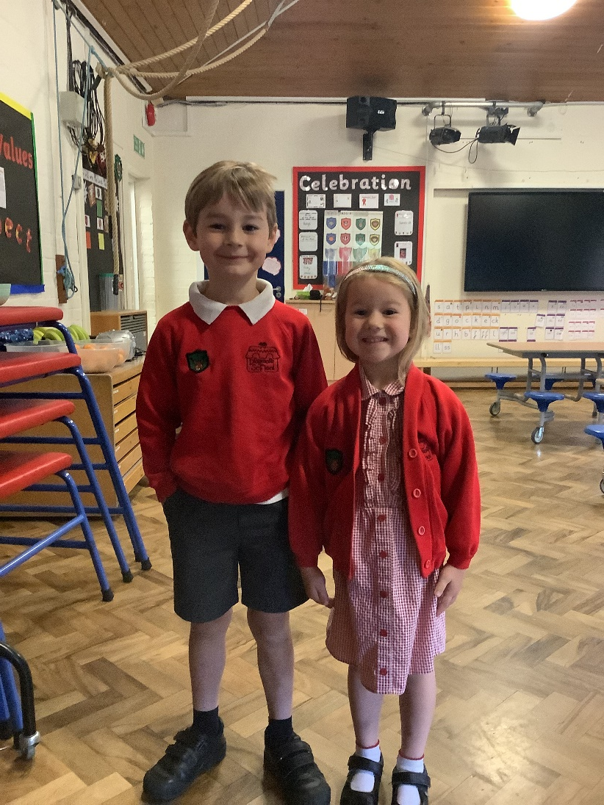
6. UNIFORM
Please ensure that your child’s name is in all items of clothing, including shoes and socks!
You can use:
Iron on labels / sew in labels / sticky labels / laundry pen (available online or from the Uniform shop)
Please provide your child with a full spare set of uniform to be kept at school.
LABEL EVERYTHING – PLEASE!

Slide 17
6. UNIFORM
We recommend that you buy jumpers a size bigger than needed as this helps children change independently and gives them some room for growing!
Your child will be taking part in lots of interesting and sometimes messy experiences, so may come home dirty! It is all part of the learning and fun!

Slide 18

6. UNIFORM - HOUSE SYSTEM
1 badge for free
Additional badges £1

Slide 19

7 Communication
Dojo –
Directly contact Mrs Carroll and Mrs Burrell-Brown.
Share learning experiences at school – these will be weekly updates for the whole class
For you to share learning from home
Reading Record – for logging reading carried out at home or at school
Contact the office – Medical appts, after school clubs and urgent messages

Slide 20
7. COMMUNICATION - EMAIL
School Office – Mrs Fearon
office@dropmore.school
Headteachers – Mrs Waugh & Miss Douglas
head@dropmore.school
Wellbeing – Mrs Waugh
wellbeing@dropmore.school
SENCO – Miss Douglas
senco@dropmore.school

Slide 21
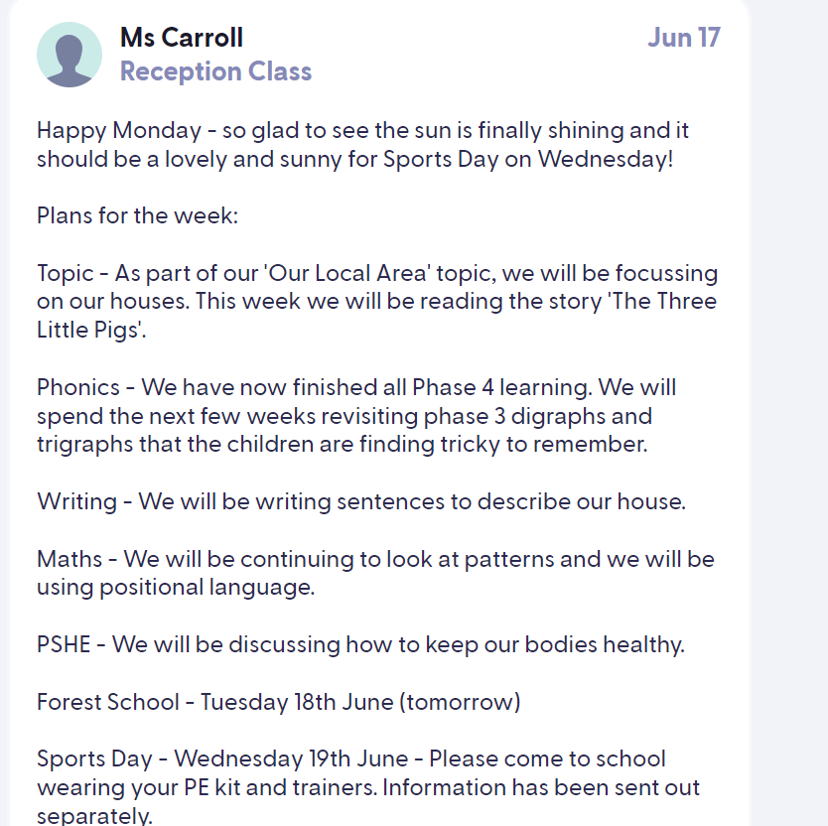

7. COMMUNICATION
Every Saturday you will receive a copy of our weekly newsletter.
Class teachers also give regular updates on Dojo

Slide 22
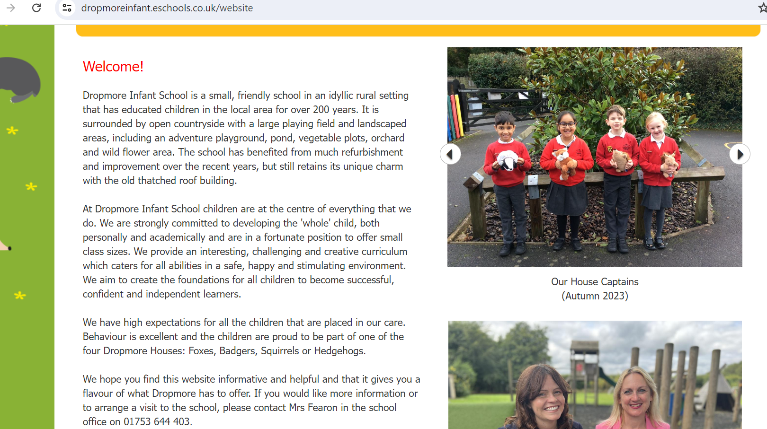
7. COMMUNICATION - WEBSITE
https://dropmoreinfant.eschools.co.uk/website

Slide 23

7. COMMUNICATION – CLASS REPS
Each class usually has 2 parents who volunteer as class reps. They set up the communication group for the class (Whatsapp) and liaise with the PTA.
It would be lovely to have 2 parents step forward to volunteer for this role.
We plan to have a parent forum coffee mornings in the year where the parent reps meet with Miss Douglas & Mrs Waugh.

Slide 24
SAFEGUARDING
We are committed to safeguarding and promoting the welfare of all our children.
Site Security:
Please only enter the school through the front entrance. You will be asked to sign in and wear a lanyard (green or red) while on site. This tells the children that it is OK for you to be on site.

Slide 25
MEDICAL MATTERS
Any sickness or diarrhoea, must be followed by 48 hours
absence from the last bout.
All absences require a telephone call or email explaining the reason for absence before 9am.
Head lice are common! Please check regularly and treat as recommended.
Prescription and some over the counter medicines can be administered by staff. A form will need to be completed.
Please speak to us if your child has any allergies or ongoing medical needs. A Health Care Plan will need to be implemented.

Slide 26
ATTENDANCE & PUNCTUALITY
Good attendance is important!
Punctuality is important!
For more information, please read our Attendance Leaflet. Our Attendance Policy is available on the website.
Leave of absence in term time will only be authorised in exceptional circumstances.

Slide 27
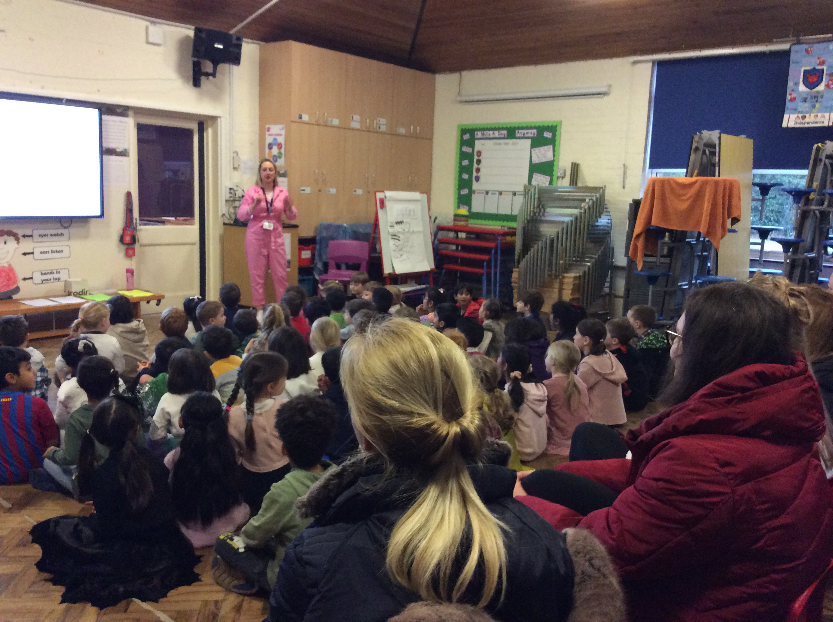
WELLBEING
We believe that children can only learn well when their own wellbeing and that of the adults around them is in a positive state .
We have a successful wellbeing curriculum which includes whole school assemblies and activities and small group and 1:1 sessions to provide children with the tools to face the challenges that life throws at them.

Slide 28
8. GETTING READY FOR SEPTEMBER
When your child joins us in Reception we would like
them to be able to:
Put their coat on and take it off
Go to the toilet, wipe and wash hands
Take off and put on their shoes
Dress and undress for PE (including socks and tights)
Use a knife and fork to feed themselves
INDEPENDENTLY

Slide 29
9. ONE MORE THING…
If you would like your child to be addressed in a shortened version of their name in school, please let us know as soon as possible.
This will allow them to get all the labels prepared for September.

Slide 30
Welcome to the Dropmore family
Please feel free to ask any questions

